Slide 1



UBER Data Analysis using R
By Karan Katyal

Slide 2


OBJECTIVES
We are performing a data visualization project on R
Here we will use R and its libraries to analyze the data with various parameters
We will use the Uber Pickups in New York City dataset and create various visualizations for different time frames of the year.

Slide 3

Here we use the Uber raw data from April 2014 to September 2014
We will read the data separately in R and then we will combine that data using R bind function

Slide 4

VISUALIZATIONS:

Slide 5
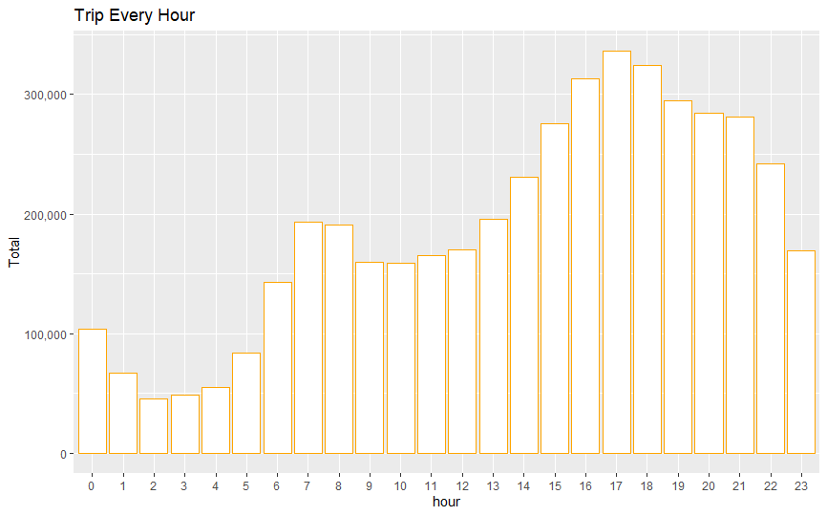
Trips Every Hour

Slide 6
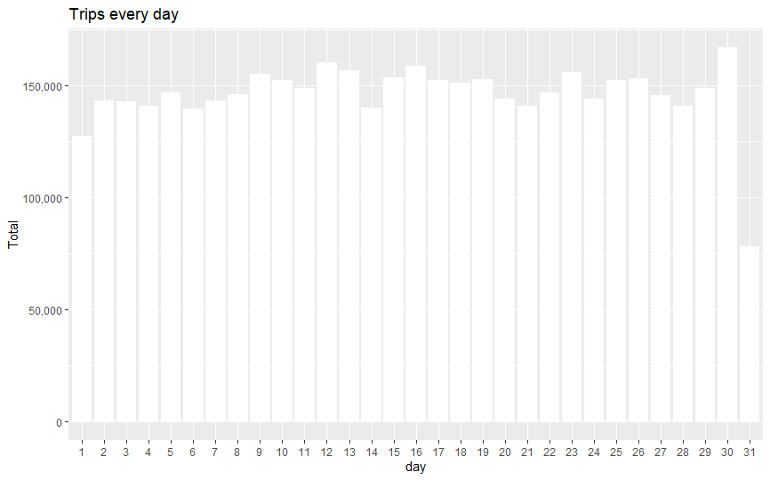
Trips Every Day

Slide 7
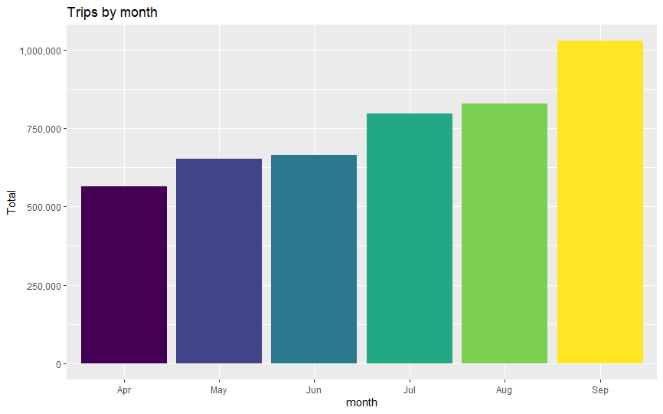
Trips By Month

Slide 8
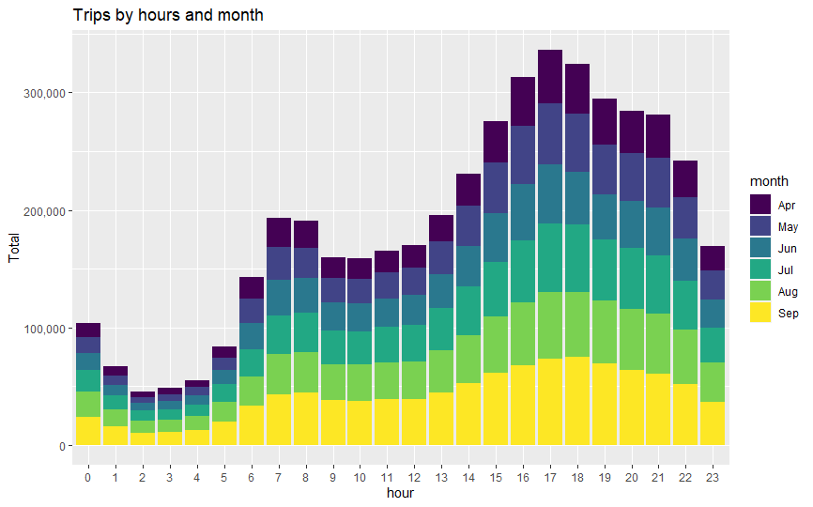
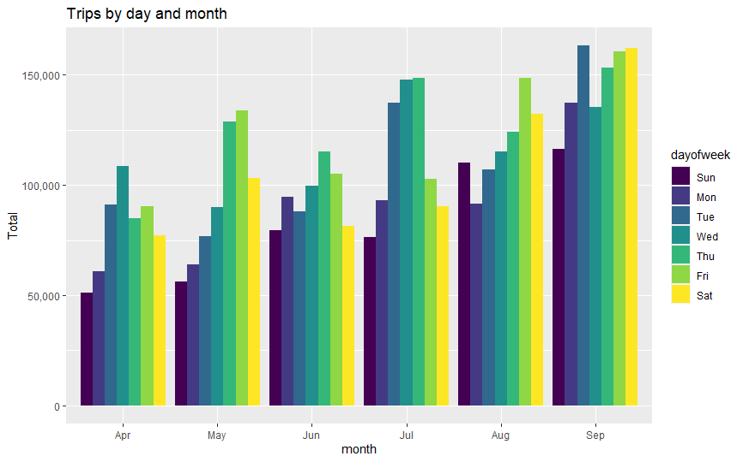
Trip By Hour and month , Trip by Day and Month

Slide 9
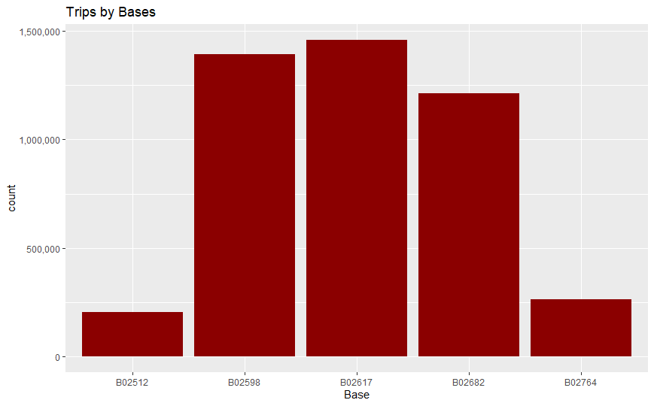
Trip By Bases

Slide 10
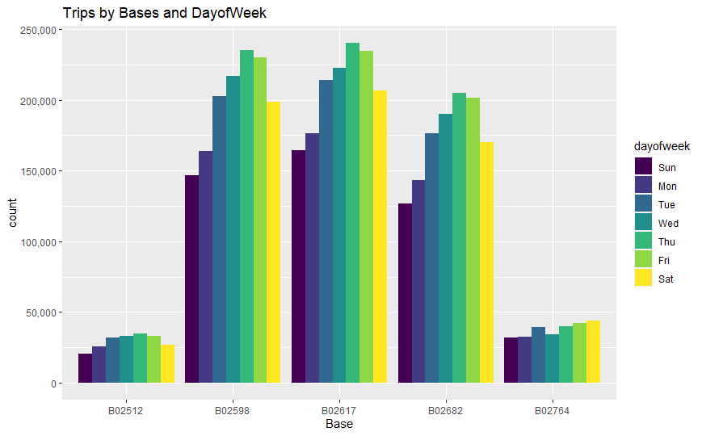
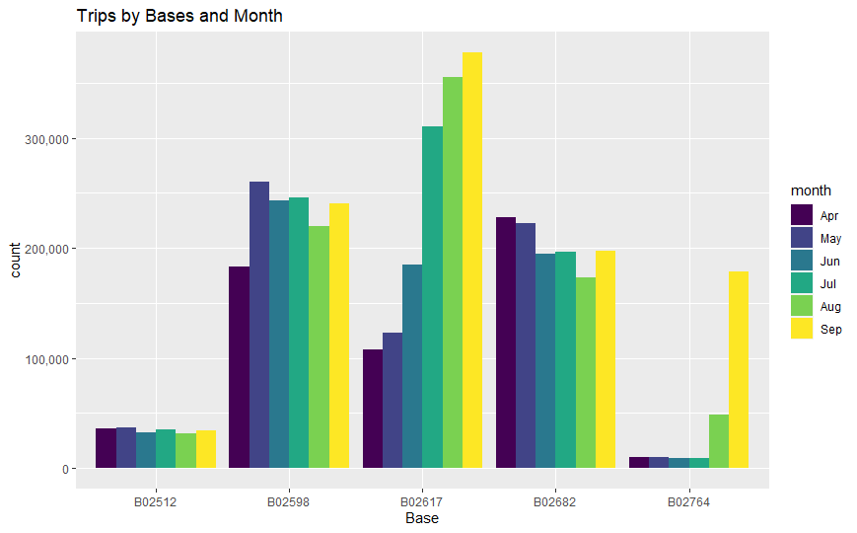
Trips by Bases and day of Week , Trips by Bases and Month

Slide 11

The number of trips are higher in the evening around 5 and 6PM
30th of the month had the highest trips(167160) in the year which is mostly contributed by the month of April
Most trips were made during the month of September(1028136)
Base B02617 had the highest number of trips.
Thursday observed highest trips in the three bases-B02598, B02617, B02682.

